Slide 1

ಬಿ.ಎಂ.ಎಸ್. ತಾಂತ್ರಿಕ ಮತ್ತು ವ್ಯವಸ್ಥಾಪನಾ ಮಹಾವಿದ್ಯಾಲಯ
BMS Institute of Technology and Management
(An Autonomous Institute affiliated to VTU, Belagavi)
Avalahalli, Doddaballapur Main Road, Bengaluru – 560119
Efficient Internet of Things based Smart Dustbin using GSM module
BRINDA.M
KEERTHANA REDDY
KAVYA .Y
NAMITHA K.G
UNDER THE GUIDANCE OF
Dr.Niranjanamurthy M
DEPARTMENT OF AI&ML

Slide 2
AGENDA
Introduction
Literature Survey
Methodology
Results & Discussion
Conclusion
References

Slide 3
INTRODUCTION:
Things are becoming smart not only in public places but also in private sphere. Waste is a crucial part of any organism existence and managing the waste is essential for our species to survive and attain sustainable development.
The main objective of this project is to manage the waste filled in the dustbin in a smarter way .We achieve this task by using the concept of GSM module.
The system even includes the features like automatic SMS alert. The Smart Dustbin with Waste Segregation is an innovative solution designed to enhance waste management efficiency.
This system employs sensor technology to detect and classify types of waste deposited into the bin, facilitating automated segregation.
The user-friendly mobile application provides insights into waste composition and disposal patterns, promoting environmental awareness.
Hence in this busy world, a tension free automatic management of waste becomes imperative in saving of time and reduces the cost to the environment.

Slide 4
LITERATURE SURVEY
"Smart Garbage Monitoring and Clearance System using Internet Of Things"
2017 IEEE International Conference on Smart Technologies and Management for Computing, Communication Controls, Energy and Management (ICSTM). This paper introduces a system for the management of collection of waste. It precisely focuses on the issue of overflow of waste in the dustbins due to inefficient collection. An android application is presented to display the status of the bin le, if the bin is full or normal. The user needs to open the app to know the status and it is automatically updated according to the sensors in the bin.
They make use of Google maps to establish the location of the bin so that the assigned worker could go and collect the waste from the dustbin when it is full. When the bin is full, the status is updated and is shown to the user. There is a map option to directly see which bin is full. The status of the bin is also displayed on the LCD display on the bin such as 'bin normal', 'bin full' and 'high weight'. Implementation of this project is done by a user who needs to login to his account to access the information on dustbins. GSM module is used here to send a message when the bin is full and heavy. RFID is used to provide different identity to each bin. This system does not consider the later process for waste management that is waste segregation. It does not take into account on what should happen to the huge amounts of waste that is being collected. This can only be implemented on dustbins which are huge and where lots of waste will be placed.

Slide 5
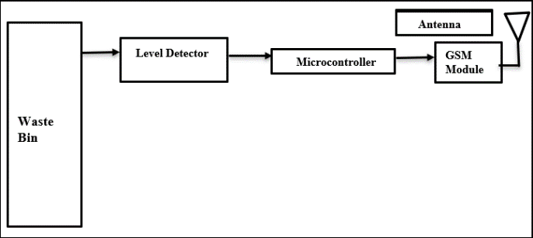
Methodology
Fig 1: The block diagram of the transmitter
The smart dustbin system begins with identifying key requirements such as automatic lid operation, waste level sensing, GSM-based alerts, and waste segregation. These features enhance convenience, hygiene, and efficient waste management. Suitable components are then selected, including an ultrasonic sensor for waste level detection, a servo motor for lid operation, a GSM module for alerts, a soil sensor for waste segregation, and a reliable power source.

Slide 6
These components are integrated into the system, with the ultrasonic sensor connected to an Arduino board to monitor waste levels, the servo motor controlling lid movement, the GSM module sending SMS notifications when the bin is full, and the soil sensor classifying waste based on moisture content. The system is powered by a consistent energy source to ensure uninterrupted functionality. Custom Arduino-based code is developed to manage sensor data and control system operations, ensuring seamless interaction between components. Before deployment, rigorous testing is conducted, including calibration of the ultrasonic sensor for accurate waste level detection, verification of the GSM module for message transmission, and assessment of the soil sensor for effective waste segregation. Once testing is successful, the smart dustbin is installed in the desired location, and users are trained to interpret alerts and operate the system effectively. Regular maintenance schedules are established to ensure long-term functionality, and provisions are made for future upgrades to enhance system performance and adaptability to evolving waste management needs.

Slide 7
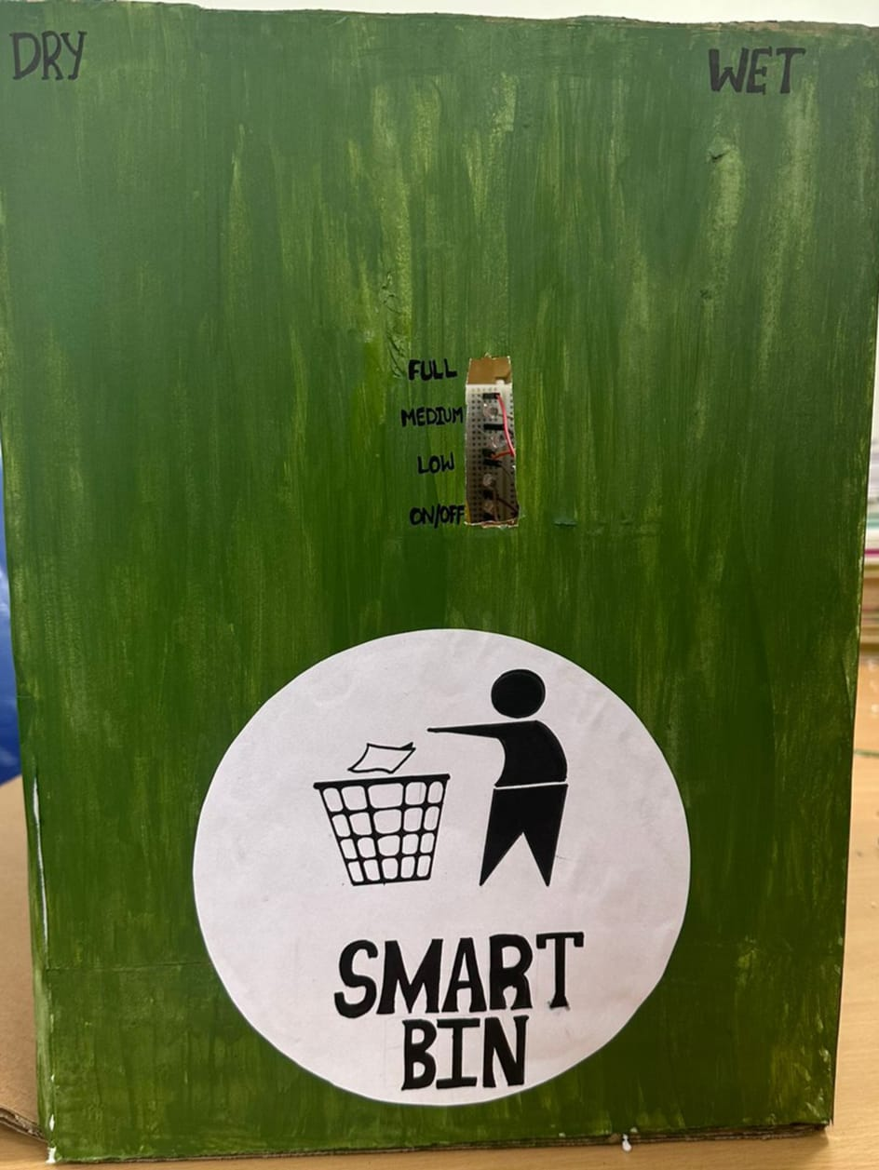
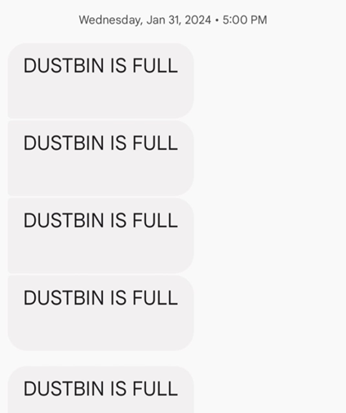
Results and Discussions
We can segregate wet and dry waste in the bin without manually separating it. And also detect when the dustbin is full and send SMS to the garbage collector so that there will be no fuel wastage and also this involves automatic opening and closing of lid where IR sensor is used.
Fig 2: SMS notification
Fig 3:Prototype

Slide 8
Conclusion
By this project, we can conclude that the waste that is disposed on the roads or streets can be prevented and can protect our environment. In this project, we can segregate waste that is wet and dry waste. Once the dustbin is full, SMS notifications will be sent to authorized user. Implementing a smart dustbin with a GSM module brings numerous benefits. Firstly, it enhances efficiency by enabling real-time monitoring of waste levels, allowing for timely collection and optimization of waste management routes. This can lead to cost savings and a more environmentally friendly approach by reducing fuel consumption and emissions from unnecessary collection trips. Authorities can receive alerts when the bin is nearing capacity or requires maintenance, ensuring timely intervention and preventing overflow or other issues. Overall, the integration of a GSM module into smart dustbins enhances operational efficiency, promotes sustainability and facilitates informed decision-making in waste management practices. We can segregate wet and dry waste in the bin without manually separating it. And also detect when the dustbin is full and send SMS to the garbage collector so that there will be no fuel wastage and also this involves unmanned opening and closing of lid where IR sensor is used.

Slide 9
REFERENCES
[1] P. Thirumugam, D. Herath and S. Amarasooriya, "Smart Dustbin and Garbage Monitoring System Using Internet of Things," 2023 5th International Conference on Advancements in Computing (ICAC), Colombo, Sri Lanka, 2023,pp.857-861, doi: 10.1109/ICAC60630.2023.10417205.
[2] M. Ahmed, R. Shaha, K. Sarker, R. B. Mahi and M. A. Kashem, "Design and Implementation of Intelligent Dustbin with Garbage Gas Detection for Hygienic Environment based on IoT," 2022 International Conference on Advancement in Electrical and Electronic Engineering (ICAEEE), Gazipur, Bangladesh,2022,pp.1-7,doi: 10.1109/ICAEEE54957.2022.9836479.
[3] G. R. Poornima, N. Bindu Shree, S. Aishwarya and K. M. Nayana, "Solar Photovoltaic Powered Smart Garbage Monitoring System Using GSM/GPS," 2018 3rd IEEE International Conference on Recent Trends in Electronics, Information & Communication Technology (RTEICT), Bangalore, India, 2018, pp. 10.1109/RTEICT42901.2018.9012528. 2466-2469,doi:10.1109/RTEICT42901.2018.9012528.

Slide 10
[4] S. S. Pawar, S. Pise, K. Walke and R. Mohite, "Smart Garbage Monitoring System Using AVR Microcontroller," 2018 Fourth International Conference on Computing Communication Control and Automation (ICCUBEA), Pune, India, 2018, pp. 1-4, doi: 10.1109/ICCUBEA.2018.8697585.
[5] R. K. Singhvi, R. L. Lohar, A. Kumar, R. Sharma, L. D. Sharma and R. K. Saraswat, "IoT Based Smart Waste Management System: India prospective," 2019 4th International Conference on Internet of Things: Smart Innovation and Usages (IoT-SIU), Ghaziabad, India, 2019, pp. 1-6, doi: 10.1109/IoT-SIU.2019.8777698.
[6] A. Mohiuddin, M. Iqbal, N. Kumar, S. Anjum and S. Nanda, "Automated Garbage Management System for Smart City Applications," 2021 IEEE 2nd International Conference on Applied Electromagnetics, Signal Processing, & Communication (AESPC), Bhubaneswar, India, 2021, pp. 1 5, doi: 10.1109/AESPC52704.2021.9708495.

